Slide 1
Euchre Player AI
Progress Report #1
Team 8 – Andrew Klenotic & Dylan STavarz

Slide 2
Current Progress Points
Initially we will be making cards with barcode printing and a barcode reader to let the computer know the cards played and the cards dealt to it so that the humans do not have to know the cards.
So far we have a basic decision tree written with basic strategy for the game and rules for both the calling round and for playing each hand.
Defined basic internal representations, functions and main program loop.
Finalized decisions on interface.

Slide 3
Internal Representation
Rank | 9 | 10 | Jack | Queen | King | Ace
Integer | 9 | 10 | 11 | 12 | 13 | 14
Suit | Spades | Diamonds | Hearts | Clubs
Character | S | D | H | C
struct Card {
char suit;
int size;
}
The AI’s hand is represented as a 5 value array of type Card.
The cards played are represented in a separate array.

Slide 4
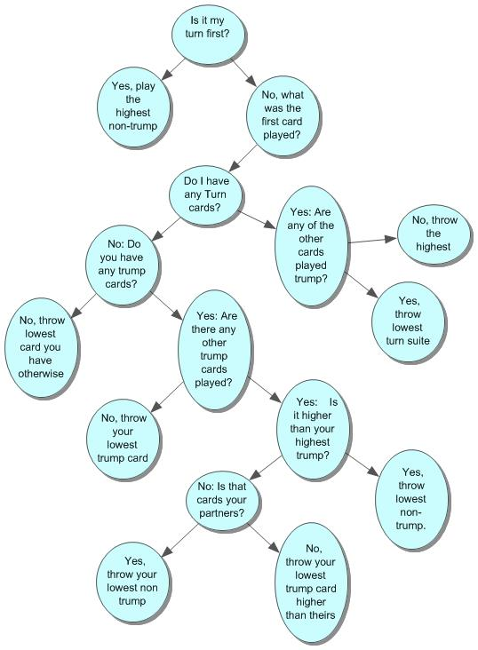
Decision Tree (Hand)

Slide 5

Interface
Barcode scanner chosen for ease of use and quickness of play.
We will print custom cards with barcodes for the AI to read so that humans do not need knowledge of AI hands.

Slide 6
Next Stage Points
Continue work on voice synthesis so AI can “talk” to players.
Development of LED device to allow AI to indicate which card is to be played.
Playtesting the algorithm/decision tree and adjusting as needed.
Finalizing code.
Consider stretch goals from previous presentation (keeping score, etc.)

